Slide 1
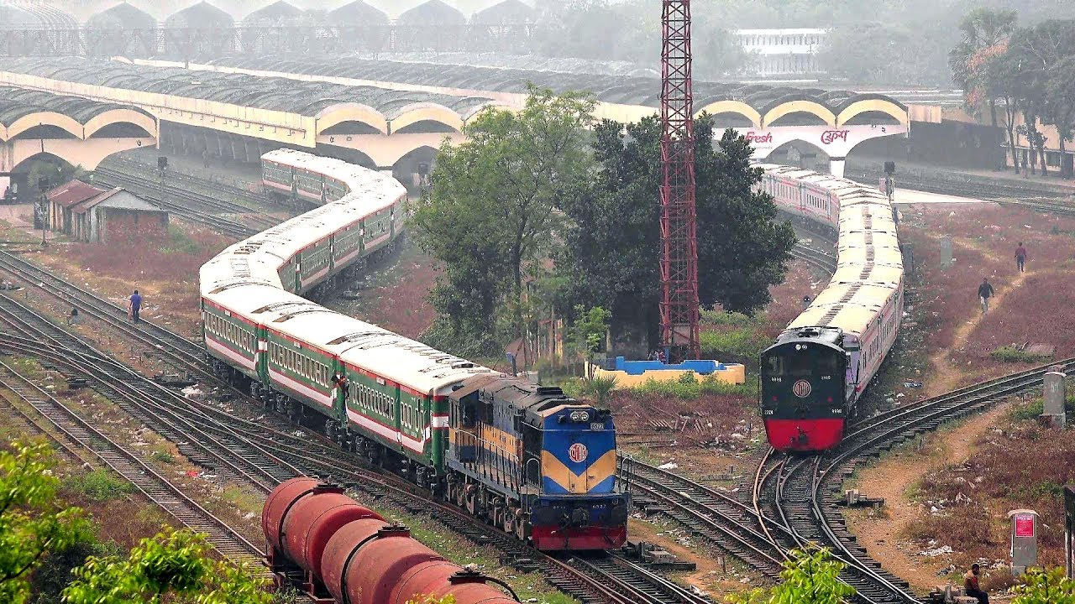
Railway Reservation System (Software Development Project- 1)

Slide 2

Supervised by:
M. M. Fazle Rabbi
Assistant professor
Department of Computer Science and Engineering
Bangladesh University of Business and Technology
Presented by:
Syeda Nowshin Ibnat (ID:17183103020)
Mahmuda Begum (ID:17183103030)
Fatema-Tuz Zohra (ID:17183103009) Intake-39(section-1)
Dept. of Computer Science and Engineering

Slide 3
Outline
Introduction
Problem Statement
Objectives
Technology
Modules
Use Case Diagram
Flow chart
Benefits
Conclusion

Slide 4
Introduction
The basic functions being performed by our system are reservation and cancellation.
It contains information about the trains.
It also contains information about the Seat Availability.
Reservation Possibilities.
Train Ticket booking.

Slide 5
Problem Statement
Reserve seat: A passenger should be able to reserve a seat in the train specified by him if available. For this he has to fill the required information.
Cancel reservation: There may arise a case when the passenger wants to cancel his reservation. For this he has to provide his phone number.

Slide 6
View Information of the passengers: Only the Admin can do this task.
Update train information: All the users should be able to see the information about the reservation status & train schedule, train name, train number etc.

Slide 7
Objective
This project intends to introduce more user friendliness in the various activities. The activities of our System are going to be like:
View information
Book ticket
Cancel ticket
Search for particular ticket

Slide 8
Admin
View passengers
Add train
Delete train
Exit

Slide 9
Technology
Code::Blocks :
Code Blocks is a free, open source cross-platform IDE(integrated development environment)that supports multiple compilers.
Currently, Code Blocks is oriented towards C, C++, and Fortran.
Code Blocks is being developed for Windows and Linux.
Version 17.12 is the latest stable release.(release date: December 30, 2017).

Slide 10
User Module
View Information
Book ticket
Cancel Ticket
Search for Particular ticket

Slide 11
Admin Module
Login
View Passengers
Add Train
Delete train

Slide 12
Use Case Diagram for User
User
View Information
Book ticket
Cancel ticket
Search for Particular ticket

Slide 13
Use Case Diagram for Admin
Admin
Login
View Passengers
Add Train
Delete Train
Back

Slide 14
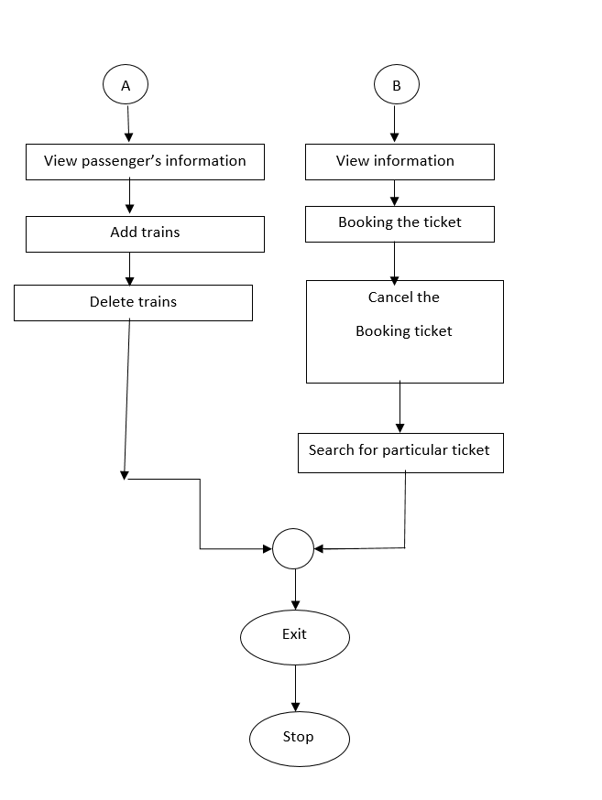
Flow Chart

Slide 15
Benefits
This system is very easy to use.
It produces an easier and flexible way of booking.
Actually passengers use this system to reserve tickets.
Also they can easily cancel their reservation.
Passengers can Search for particular ticket.
This system consists with security.
We can add more features to modify this project in future.

Slide 16
Conclusion
The main aim of developing this project was to provide all the information that is required by users.
Our project is user friendly. So, users can get all the information without complicated searching.
Other important things of this system are: data security, extensibility and maintainability.
This project greatly helped us to understand the various phase in software development.

Slide 17
Thank You!

